Slide 1
Conditional Statements in JavaScript
Understanding if, else, and Nested Statements

Slide 2
Introduction to Conditional Statements
What are Conditional Statements?
Control the flow of execution based on conditions.
Types of Conditional Statements:
if Statement
Nested if-else Statement
if-else Ladder
if-else Ladder with Logical Operators

Slide 3
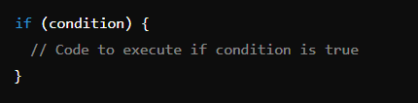
The if Statement
Definition: Executes a block of code if the specified condition is true.
Syntax :

Slide 4
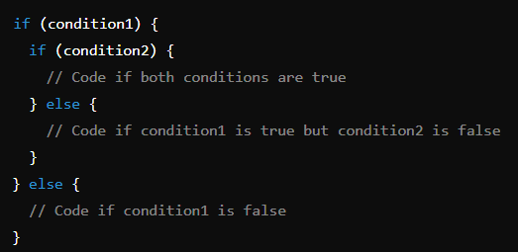
Nested if-else Statement
Definition: An if-else statement inside another if or else block.
Usage: Used to check multiple conditions.
Syntax :

Slide 5
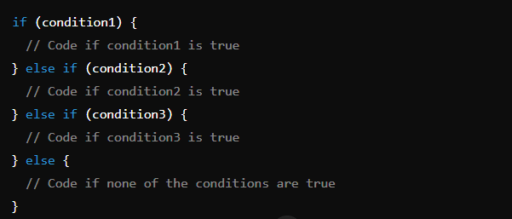
The if-else Ladder
Definition: A series of if-else statements used to choose among multiple options.
Syntax:

Slide 6
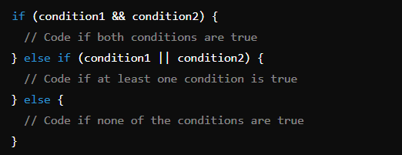
if-else Ladder with Logical Operators
Definition: Using logical operators (&&, ||, !) to combine conditions in if-else ladder.
Logical Operators:
&& (AND): True if both conditions are true.
|| (OR): True if at least one condition is true.
! (NOT): Inverts the boolean value.

Slide 7
Summary of Conditional Statements
if Statement: Basic condition checking.
Nested if-else: Multiple levels of conditions.
if-else Ladder: Multiple conditions with different outcomes.
if-else Ladder with Logical Operators: Combining conditions with logical operators.

